Slide 1



Introduction to GitHub Copilot
Introduction to Github Copilot
Exploring AI assistance in coding workflows
by RocketMind academy

Slide 2










RocketMinders
www.linkedin.com/in/luismanez
www.linkedin.com/in/rubentg
luis.manez@outlook.com
rtoribiogallardo@gmail.com
github.com/luismanez
github.com/Rtoribiog
twitter.com/luismanez
twitter.com/Rtoribiog
Luis Mañez
Ruben Toribio
RocketMind Academy CTO
RocketMind Academy CEO
Azure AI + M365 Development MVP
AI Expert / Full stack developer

Slide 3
01
Overview of GitHub Copilot

Slide 4

What is GitHub Copilot?
AI-Powered Coding Assistant
GitHub Copilot serves as an AI-powered coding assistant, enhancing your development process by suggesting code completions.
Real-Time Code Suggestions
Copilot provides real-time code suggestions and can complete entire functions, streamlining your coding workflow.
Learning Your Coding Style
It adapts to your coding style and intentions, offering personalized suggestions that match your preferences.

Slide 5
02
Benefits of Using GitHub Copilot

Slide 6

Faster Coding and Multi-Language Support
Enhanced Coding Speed
Copilot allows developers to write code faster and reduces boilerplate code, enabling a focus on complex logic.
Repetitive Code Generation
By generating repetitive code and scaffolding functions, Copilot simplifies developers' tasks, increasing overall productivity.
Multi-Language Flexibility
Copilot supports numerous programming languages, making it versatile for developers working in various environments.

Slide 7
03
Integration with Development Environments

Slide 8

Supported Environments
Visual Studio Code Integration
Copilot integrates seamlessly with Visual Studio Code, providing suggestions as you type and enhancing productivity.
JetBrains IDEs Support
Copilot works smoothly in JetBrains IDEs, providing in-line suggestions and chat functionality to assist coding efforts.
Web-Based Copilot
Users can access Copilot on GitHub's web platform for code editing, pull requests, and more, facilitating quick edits.
Terminal Command Assistance
Copilot aids in the command line interface, helping users with command suggestions and enhancing terminal functionality.

Slide 9
04
Signing Up for GitHub Copilot

Slide 10
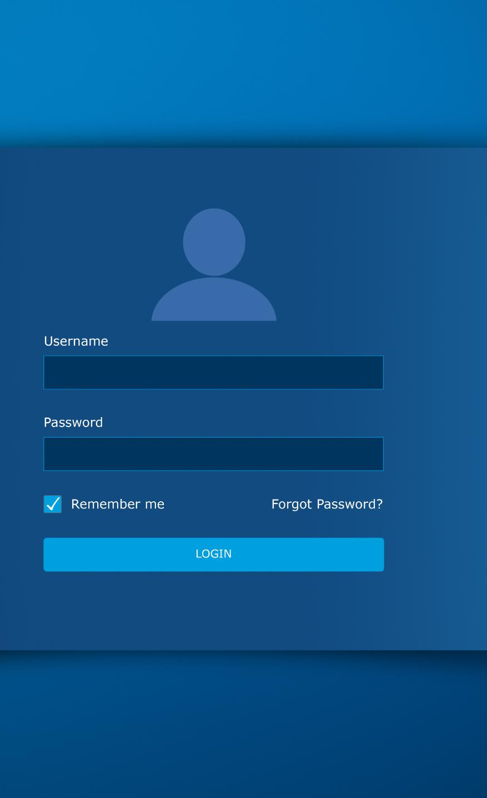
How to Sign Up
Understanding Copilot
GitHub Copilot is a subscription service that offers a free tier and professional options for developers.
Signing Up Process
To start using Copilot, log into GitHub and navigate to the Copilot section to select your plan.
Activation and Integration
After signing up, activate Copilot on your account and log in through your integrated development environment (IDE).
https://github.com/copilot?ref_cta=Copilot+free&ref_loc=getting+started+with+github+copilot&ref_page=docs

Slide 11
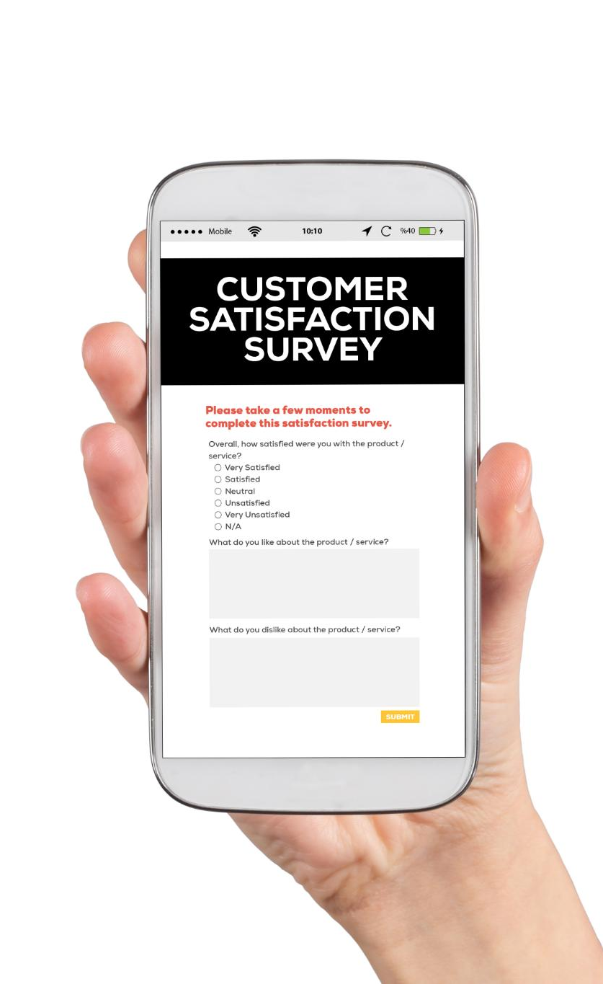
Subscription Plans
Copilot Free Tier
The Copilot Free plan provides limited features, including 2,000 code completions and 50 chat requests monthly without any cost.
Copilot Pro Plan
The Pro plan offers unlimited usage of Copilot’s features for $10/month, suitable for heavy users and professionals.
Enterprise Solutions
Enterprise plans cater to organizations with centralized billing and admin controls, offering additional features for business needs.
https://docs.github.com/en/copilot/about-github-copilot/plans-for-github-copilot

Slide 12
Premium requests
Feature | Free Plan | Premium Plan
Monthly Requests | Limited (15–30/day) | Unlimited/High Quota
Advanced Models | ❌ | ✅
Security/Tests Features | ❌ | ✅
Priority Processing | ❌ | ✅
Key Benefits of Premium Requests
Unlimited Code Suggestions : No daily limits for large projects.
Advanced AI Models : Higher accuracy and contextual understanding.
Faster Debugging : Instant error explanations and fixes.
Security & Tests : Auto-generated tests and vulnerability detection.
Code Modernization : Refactor legacy code with best practices.

Slide 13
05
Setting Up GitHub Copilot

Slide 14

Prerequisites and Installation
Supported Editor Version
Ensure your IDE is up to date to avoid compatibility issues. Check for the latest release of your editor.
Install Copilot Extension
Install the GitHub Copilot extension from the appropriate marketplace for your editor. Follow installation prompts.
Authenticate with GitHub
Log in to GitHub to authenticate the Copilot plugin. This typically requires a browser sign-in.
Internet Connection Requirement
Ensure you have an active internet connection, as Copilot relies on cloud-based AI for suggestions.

Slide 15
06
Using GitHub Copilot Chat

Slide 16

What is Copilot Chat?
Interactive Q&A
Copilot Chat acts as a conversational companion, helping users with questions and code explanations directly in the IDE.
Context-Aware Responses
Copilot Chat provides context-aware responses based on the code you have open and the conversation history.
Multi-Turn Conversations
Users can engage in multi-turn conversations, allowing for follow-up questions and deeper code understanding.

Slide 17

Capabilities of Copilot Chat
Code Explanation
Copilot Chat can explain pieces of code in plain English, helping users understand unfamiliar code quickly.
How-To Guidance
Users can ask how-to questions, receiving concise answers or code snippets that guide their programming tasks.
Test Generation
Copilot can generate tests or code snippets for functions, saving time on boilerplate code.
Debugging Assistance
Copilot provides debugging help by analyzing errors and suggesting potential fixes based on context.

Slide 18
07
Demo: Copilot Code Completion in Action

Slide 19

Tips for Effective Use
Meaningful Function Names
Using clear and descriptive function names helps Copilot provide contextually relevant suggestions for your coding.
Triggering Suggestions
If Copilot doesn't suggest code, pressing Ctrl+Enter can force it to show suggestions. Pausing after typing can also trigger suggestions.
Exploring Multiple Suggestions
Copilot may provide multiple suggestions. Use icons or shortcuts to cycle through alternatives to find the best implementation.
Editing and Iterating
Feel free to edit accepted code suggestions. This can prompt Copilot to offer further assistance and improvements.

